Slide 1

Mapping Happiness and Frustration Index on top of the world map through tweets
Chandra Prakash Khatri* M.Karthikeyan# Raja V Palanisamy*
*College of Computing, Georgia Institute of Technology#Bioinformatics, School of Biology, Georgia Institute of Technology

Slide 2


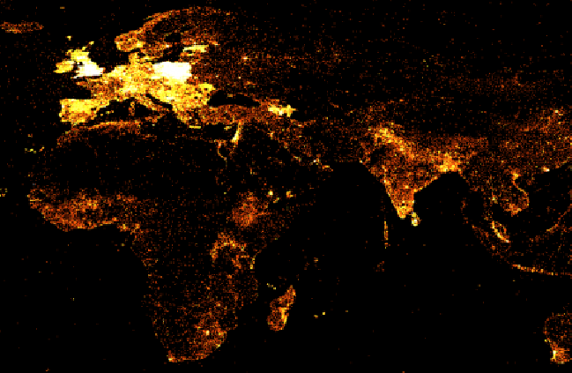

INTRODUCTION

Slide 3

MOTIVATION #OSCARS

Slide 4
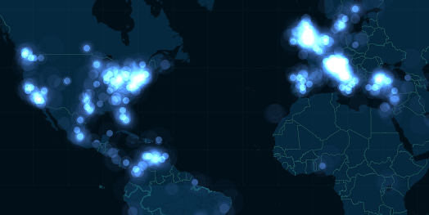
MOTIVATION #OSCARS

Slide 5
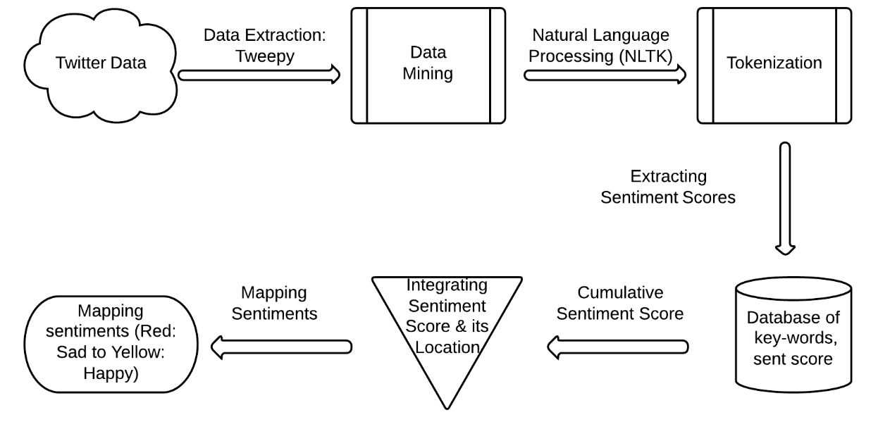
PROJECT FLOWCHART

Slide 6

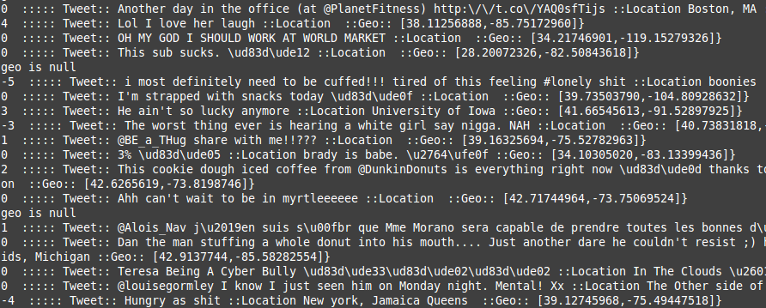
DATA EXTRACTION AND DATA MINING
Tweepy Search API
Extract Based on Location
Clean the data
Tokenize tweets
Tweetistics
645,750,000 users
2.1 billion tweets per day
9100 tweets per second
2-3% tweets geotagged
Data Input rate 273 tweets per second

Slide 7
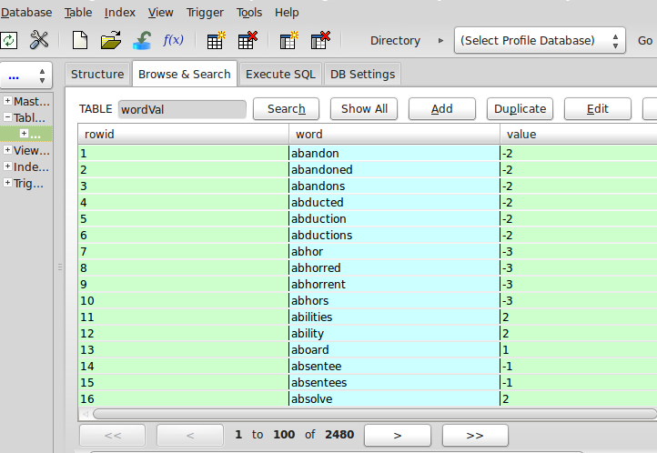
DATA ANALYTICS
Word Sentiment DB
(Stanford,Harvard)
Normalizing “Sent” vals
API to match weights in
real-time

Slide 8



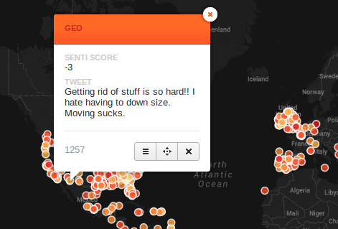
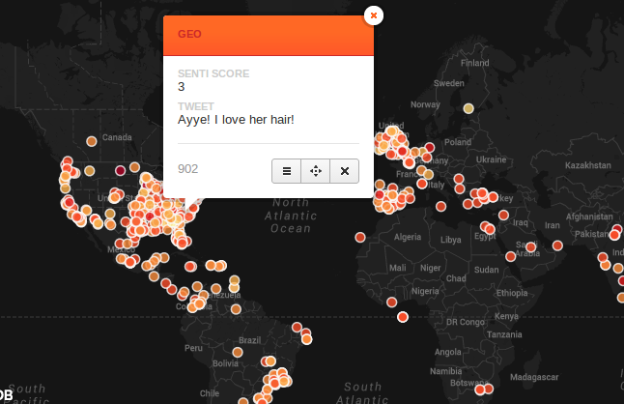
VISUAL ANALYTICS
“Frustration” Red
“Happy” Yellow

Slide 9
IN SUMMARY
Built a real time visualization tool to visualize “happy” and “frustration” tweets
Extensive database of keywords for sentiments
Sentiment scores for emoticons ! :)
Location based ‘sentiment mapping’
Dynamic visualization
Real time
Existing applications like Sentiment Viz lack a dynamic approach

Slide 10
POINTS TO IMPROVE UPON
1. Sarcasm …..
2.Visualization is binary - Index gradient not yet mapped to a corresponding color gradient
3.Sentiment analysis for non english languages

Slide 11



